Slide 1
SmartSDLC – AI-Enhanced Software Development Lifecycle
An AI-Powered
Chatbot for Software Development
Project by :
VASAGIRI HARIHARAN
ANNAMACHARYA INSTITUTE OF TECHNOLOG&SCIENCES TIRUPATI
Project Guides:
Aravind Reddy, Rithvik

Slide 2
Abstract
Smart SDLC Chat Assistant is a conversational AI tool designed to assist developers in all stages of the Software Development Life Cycle (SDLC). It provides phase-wise explanations, tool suggestions, document generation (SRS, Test Plan), and real-time Q&A. Built using Python, Google Colab, and Hugging Face API.

Slide 3
Objectives
Assist in understanding each SDLC phase
Provide AI-based suggestions for tools/practices
Enable Q&A for software-related queries
Auto-generate SRS and Test Plan documents
• Provide a well-defined sequence of phases planning, design, development, etc.).
• Clarify roles, responsibilities, and expectations for each team member.

Slide 4
Tools & Technologies
Python
Google Colab
Hugging Face Transformers
DialoGPT Model
Prompt Engineering

Slide 5
SmartSDLC Methodology
The chatbot receives user input, constructs a prompt for the Hugging Face model, and returns contextual responses. Document templates are created using string formatting.

Slide 6
Features Implemented
SDLC Phase Explanations
AI-Based Tool Suggestions
Document Generator (SRS/Test Plan)
Chat Interface for Q&A

Slide 7
Implementation Flow
User Input → Prompt Formatting → Hugging Face API → Response → Display or Document Generation

Slide 8
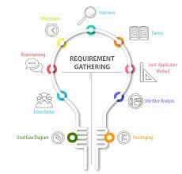
Technical Requirements
- Python 3.10+
- Google Colab or Jupyter Notebook
- Required Libraries Installed
- Internet (for OpenAI/NLP APIs if used)

Slide 9
Sample Output
Input: Explain the design phase
Output: Design phase involves creating software architecture...
Input: Generate SRS for Shopping App
Output: 1. Introduction 2. Functional Requirements...

Slide 10
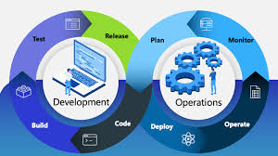
Challenges & Constraints
- Limited real AI due to no API (demo version)
- Cannot handle very complex requirements
- Dependent on clear input format
- Requires manual validation for generated output

Slide 11
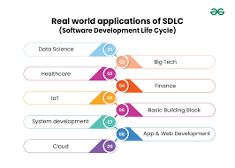
Applications
- Automating SDLC in startups
- Quick prototyping for students and developers
- Bug detection in early-phase development
- Training AI-based assistants in coding

Slide 12
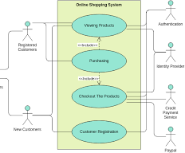
Example Use Case: Online Shopping
Requirement: Build a user registration + cart system
SmartSDLC Output:
- User class with fields & validation
- Cart logic
- Test cases for login/checkout
- Bug prediction for incomplete logic

Slide 13
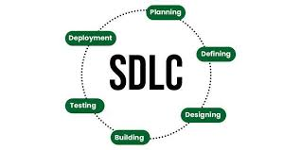
Conclusion
SmartSDLC is a novel approach that enhances traditional SDLC using AI. It streamlines each phase, reduces human error, and enables smarter, faster, and more efficient development workflows.

